Slide 1
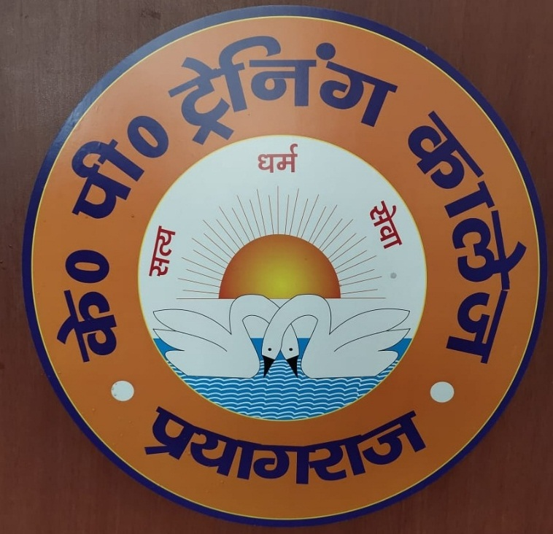
K. p. Training College Prayagraj
Course For Guidance And Counselling programme
(Add on Course)
prof. Rajesh kumar pandey

Slide 2
Course For Guidance And Counselling programme
Vision:
To prepare effective teachers who are capable of responding to the changing needs and challenges of contemporary Indian society.
To make student-teachers competent to face the challenges of modern society.
To provide an opportunity to student-teachers to handle the issues of emotional stability of students in school and colleges by providing them appropriate guidance and emotional support.

Slide 3
Aims:
To acquaint the student-teachers with concept, nature and principles of guidance and Counselling.
To make them aware of aims and process of counselling.
To acquaint student-teachers with different rolls of counsellor.
To provide working knowledge of counselling techniques and its approaches.
To make them competent to provide guidance and counselling to exceptional children.
To provide working knowledge of techniques and aims and objectives of various guidance services in schools.

Slide 4
Course content
Unit I
Meaning, nature and principles of guidance.
Aims and scope of guidance.
Needs and types of guidance.
Relationship between education and guidance.
Unit II
Meaning, definition and process of counselling.
Aims and scope of counselling.
Need and type of counselling.
Guidance and Counselling regarding exceptional children i.e. creative, talented, physically handicapped etc.

Slide 5
Unit III
Essential guidance services – orientation, information, appraisal, placement, counselling follow up.
Differences between guidance and counselling.
Various steps of Counselling.
Functions, characteristics and ethics for a good counsellor.
Unit IV
Techniques and approaches of counselling - directive, non-directive and eclectic.
Non standardized methods- rating scale, autobiography, Anecdotal record observation sociometry, interview, cumulative record, class talk etc.
Standardized methods- intelligence tests, interest inventories, aptitude test, achievement test.
Personality tools - projective and non-projective.

Slide 6
Practical
Administration of Bhatia Battery Test in real situation.
Administration and interpretation of TAT, CAT and Rorschach Ink-Blot test.
Administration of personality Inventories, interview, 16 PF, interest inventory, anxiety scale, Binet Simon Scale.
Intelligent test, verbal and nonverbal test of creativity, values test, aptitude test, social maturity test.
Instructional strategy:
Course is practical oriented in nature hence teacher will first discuss all the concepts, Tools and techniques of guidance and counselling and then students will be provided practical training in real environment to real subjects.

Slide 7
Means of assessment:
The students will be assessed on the basis of written test followed by assignment and term examination. Practicals will be conducted where students perform as counsellor in real situations
Reference books:
Duggal, Satyapal : Nirdeshan aur Paramarsh
Pal, Hansraj : Paramarsh Manovigyan
Nelson, Richard & Jones : Basic Counselling Skills
Gibson, Robert l, Michelle M.H. : Introduction to Counselling and Guidance
NCERT : Indian Mental Measurement
    Handbook

Slide 8
Distribution of Marks –
UNIT NO. TIME ALLOTED (PERIODS) MARKS ALLOTTED (%)
I 6 12
II 8 16
III 6 12
IV 10 20
Practicum 15 40
Total 100

Slide 9
Thank You

